Slide 1
Provisio Project
Team Alpha
CSD460-302O Capstone in Software Development
(2231-DD)

Slide 2
Team Introduction
Harrison Birkner (Team Leader)
Carlos Delgado
Grant Roberts
Anthony Milton

Slide 3
Sample Prototypes
The following slides show our prototypes and design process for the site, this was also the first opportunity we had working together.
Most of us decided to work off a common template, however the biggest thing that we wanted to standardize was the navigation bar at the top so that it remained the same across all pages.
One of our team members designed better on paper than through the computer, as shown on the reservation and location pages.

Slide 4
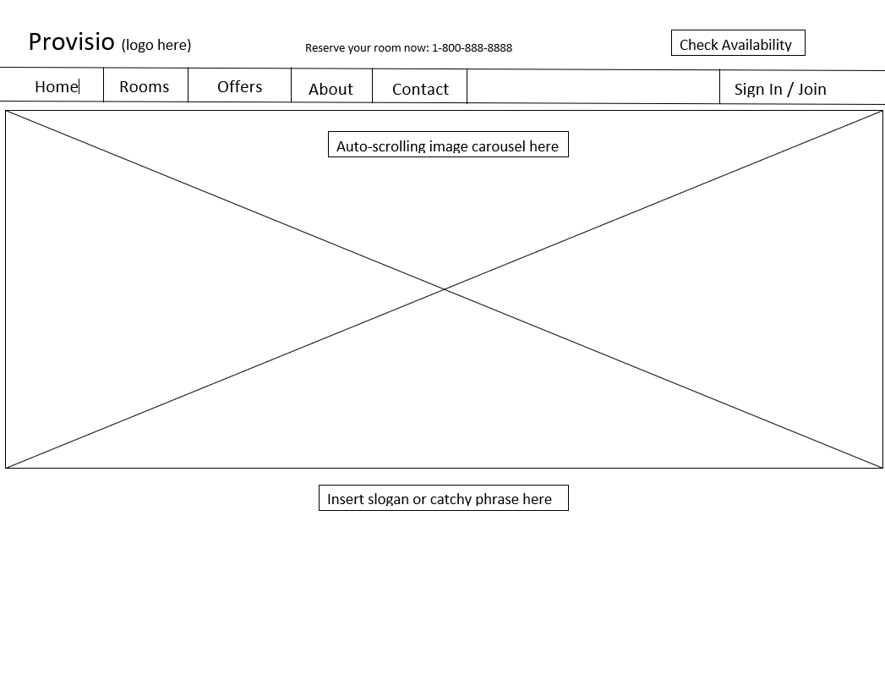
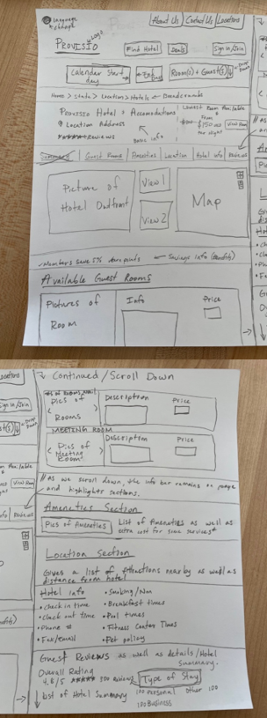
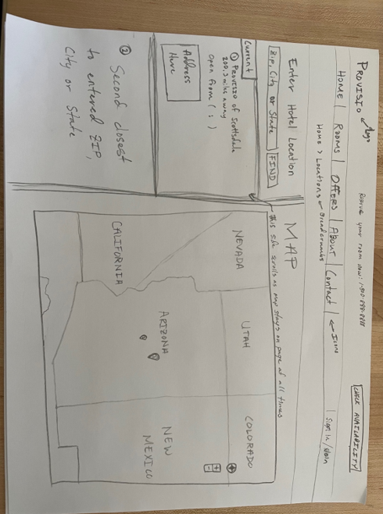
Sample Prototypes
Landing Page
Reservation Page
Location Page

Slide 5
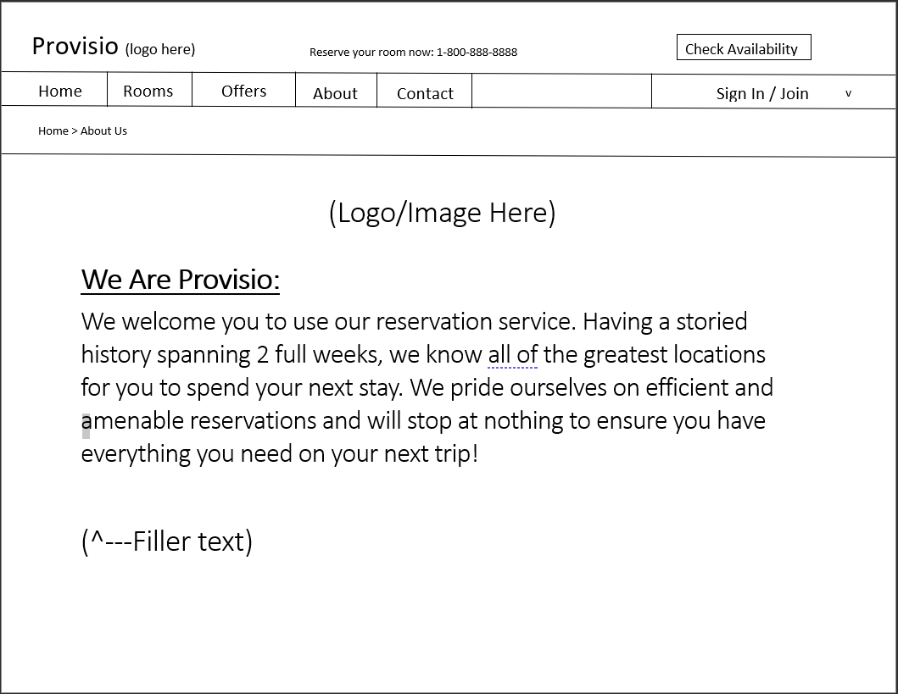
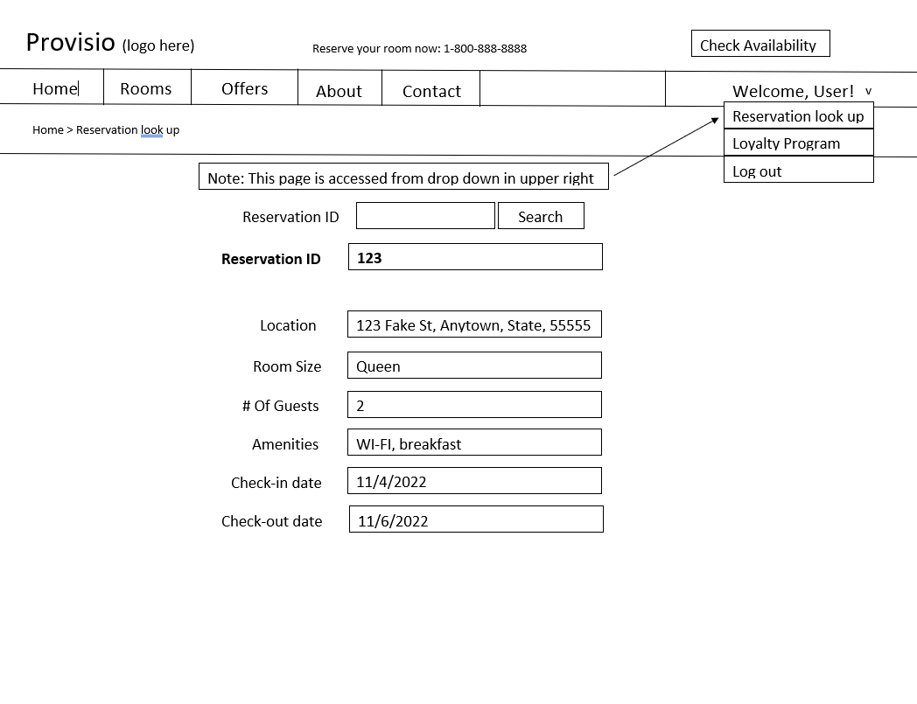
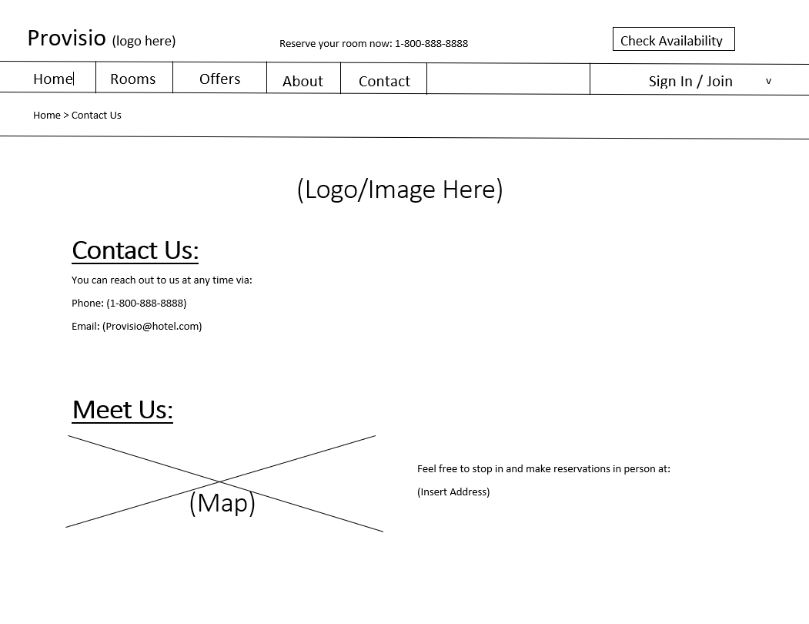
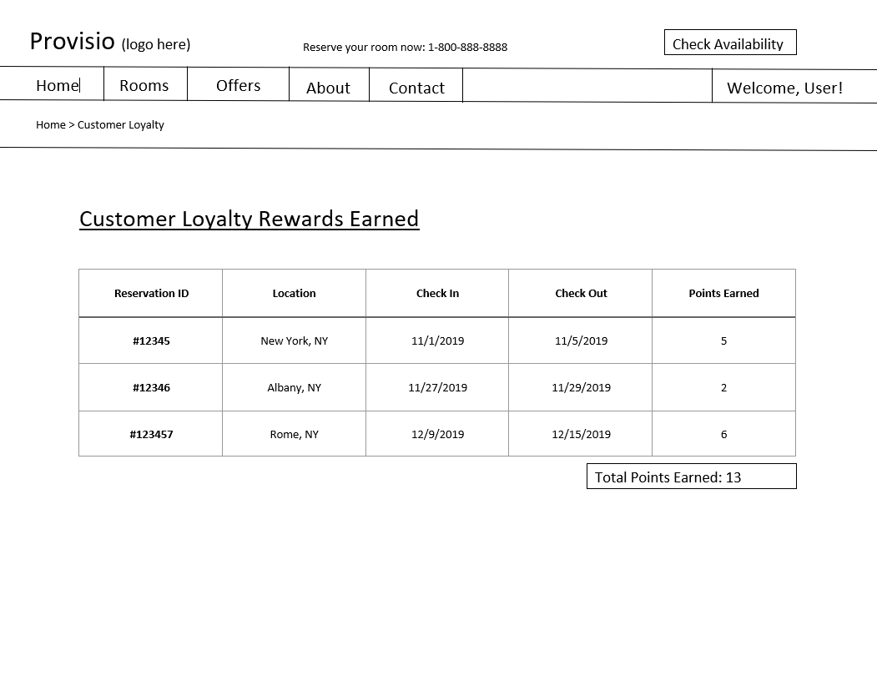
Sample Prototypes
About Us Page
Reservation Lookup Page
Contact Us Page
Loyalty Rewards

Slide 6
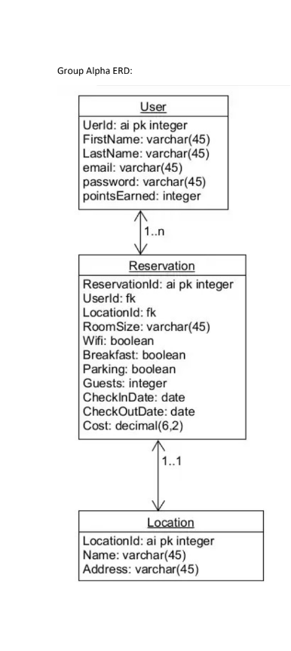
Entity Relationship Diagram
Our ERD is shown to the right, however we found we had to make some small alterations throughout the project that we did not plan for initially.
Overall this was a simple ERD, with three tables. We probably could have left out the Location table, but thinking about it as a larger company we believed that a database of locations would be required eventually.
Later Changes Included:
Multiple fields required changing to be “Not Null”
PointsEarned changed to have a default value of 0 to simplify front-end code
Password field needed to be larger than 45 characters due to hashing method, so was changed accordingly
The Location Address field was also extended to fit the full addresses needed

Slide 7
Test Example 1 of 5
Test 1 | Look Up Reservation page
 | Test Objective: Reservation look up page works properly. | Developer: Harrison Birkner Date tested: 2022/12/06 | Developer: Grant Roberts Date tested: 2022/12/06
Step | Action | Expected results: | Developer pass/fail | Tester pass/fail
1 | Connection | User can successfully connect to page. | yes | yes
2 | Refresh | Page is loaded properly after refresh. | yes | yes
3 | Info population | Information is properly loaded to database. | yes | yes
4 | Successful query | Data is queried properly for reservation. | yes | yes
Comments | All features functioned as expected and working properly. Redirection working properly and integration with database works as intended.
Description:
This test was simply to ensure that the reservation page look-up functionality was working as intended. The big things here was the page loaded, the query executed, and the page data was correct.

Slide 8
Test Example 2 of 5
Test 2 | Contact Us Page
 | Test Objective: Contact us page works properly. | Developer: Grant Roberts Date tested: 2022/12/06 | Developer: Grant Roberts Date tested: 2022/12/06
Step | Action | Expected results: | Developer pass/fail | Tester pass/fail
1 | Connection | User can successfully connect to page. | yes | yes
2 | Refresh | Page is loaded properly after refresh. | yes | yes
3 | Navigation tab | Navigation tab works properly. | no | no
4 | Contact us info loaded | Contact us info is appears. | yes | yes
Comments | Page loads as intended and functions properly for the most part. Need to work on the navigation tab and ensure that it works properly.
Description:
This test was ran to check the Contact Us Page. While most of our tests passed at first, we had issues with the navigation tab not being functional. This was remedied in a later SCRUM sprint.

Slide 9
Test Example 3 of 5
Test 3 | Loyalty Points Page
 | Test Objective: Loyalty Points Page works properly. | Developer: Harrison Birkner Date tested: 2022/12/13 | Developer: Grant Roberts Date tested: 2022/12/13
Step | Action | Expected results: | Developer pass/fail | Tester pass/fail
1 | Connection | User can successfully connect to page. | yes | yes
2 | Refresh | Page is loaded properly after refresh. | yes | yes
3 | Navigation tab | Navigation tab works properly. | yes | yes
4 | Loyalty points added | Loyalty points are added appropriately. | yes | yes
Comments | All features functioned as expected and working properly. Redirection working properly and integration with database works as intended.
Description:
This test was ran to check the Loyalty Points Page. As you can see in this test, the previous navigation tab issue was resolved in the later pages like Loyalty Points. We continued to test this as we built new pages since it was a problem in the past.

Slide 10
Test Example 4 of 5
Test 4 | Hotel Reservation Summary Page
 | Test Objective: Reservation summary page works properly. | Developer: Anthony Milton Date tested: 2022/11/29 | Peer tester: Grant Roberts Date tested: 2022/11/29
Step | Action | Expected results: | Developer pass/fail | Tester pass/fail
1 | Connection | User can successfully connect to page. | yes | yes
2 | Refresh | Page is loaded properly after refresh. | yes | yes
3 | Info population | Information is properly loaded to database. | yes | yes
4 | Successful submission | Row is created once reservations are made. | yes | yes
Comments | Change reservation | Button takes you back to reservation page. | yes | yes
Description:
This test was ran to check the Reservation Summary Page. In this test there were some specific things we needed to test with regards to information being passed to the database successfully and then displaying the results of that query input.

Slide 11
Test Example 5 of 5
Test 5 | Location Page
 | Test Objective: Locations Page works properly. | Developer: Harrison Birkner Date tested: 2022/12/13 | Developer: Grant Roberts Date tested: 2022/12/13
Step | Action | Expected results: | Developer pass/fail | Tester pass/fail
1 | Connection | User can successfully connect to page. | yes | yes
2 | Map Loads | Map is loaded properly. | yes | yes
3 | Navigation tab | Navigation tab works properly. | yes | yes
4 | Locations populate | Locations are loaded to the map properly. | yes | yes
Comments | All features functioned as expected and working properly. Redirection working properly and integration with database works as intended.
Description:
This test was ran to check the Locations Page. In this test we needed to ensure that the map was loading correctly, and that our locations from the database were also loaded to the map correctly.

Slide 12
Lessons Learned
Knowing what data is going into your databases, as well as what kinds of controls you will need on each field, is important. Although all of our database fixes from our ERD were pretty easy to implement, it would have been more difficult with a larger database.
Make sure everyone on the development team is using the same versions of Java, Tomcat, and any other software needed. We ran into numerous issues due to inconsistencies between the team at the start.
Ensure that others on the team review your work after it’s completed, or even while it’s being worked on. This way bugs or efficiencies that you may not think of can be discovered and either fixed or implemented!

